Slide 1

Grace Lake Standard Survey
July 28-31, 2025

Slide 2
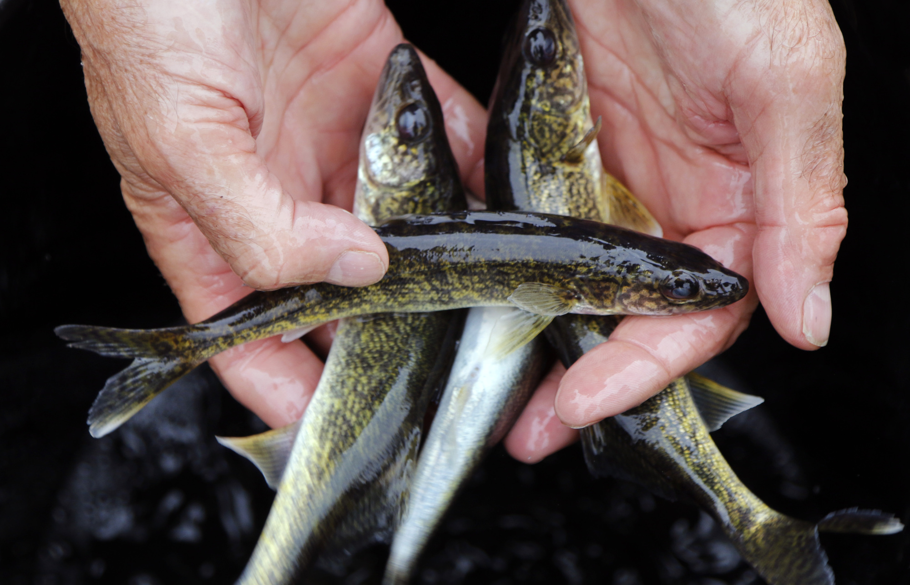
Survey every 5 years
Primarily managed for Walleye
Stocked with Walleye fingerlings annually at a rate of 1.5 lbs/littoral-acre (~500 lbs.)
Lake | Year | Species | Strain | Life Stage | Pounds
GRACE | 2015 | WAE | MIS | YRL | 539
GRACE | 2016 | WAE | MIS | ADL | 412
GRACE | 2016 | WAE | MIS | FGL | 34
GRACE | 2016 | WAE | MIS | YRL | 59
GRACE | 2017 | WAE | MIS | FGL | 508
GRACE | 2018 | WAE | MIS | FGL | 619
GRACE | 2019 | WAE | MIS | FGL | 527
GRACE | 2020 | WAE | MIS | FGL | 500
GRACE | 2021 | WAE | MIS | FGL | 195
GRACE | 2022 | WAE | MIS | FGL | 500
GRACE | 2023 | WAE | MIS | FGL | 577
GRACE | 2023 | WAE | MIS | YRL | 5
GRACE | 2024 | WAE | MIS | FGL | 250
GRACE | 2024 | WAE | MIS | YRL | 400
GRACE | 2025 | WAE | MIS | YRL | 117
GRACE | 2025 | WAE | MIS | ADL | 229
GRACE | 2025 | WAE | MIS | FGL | 300

Slide 3
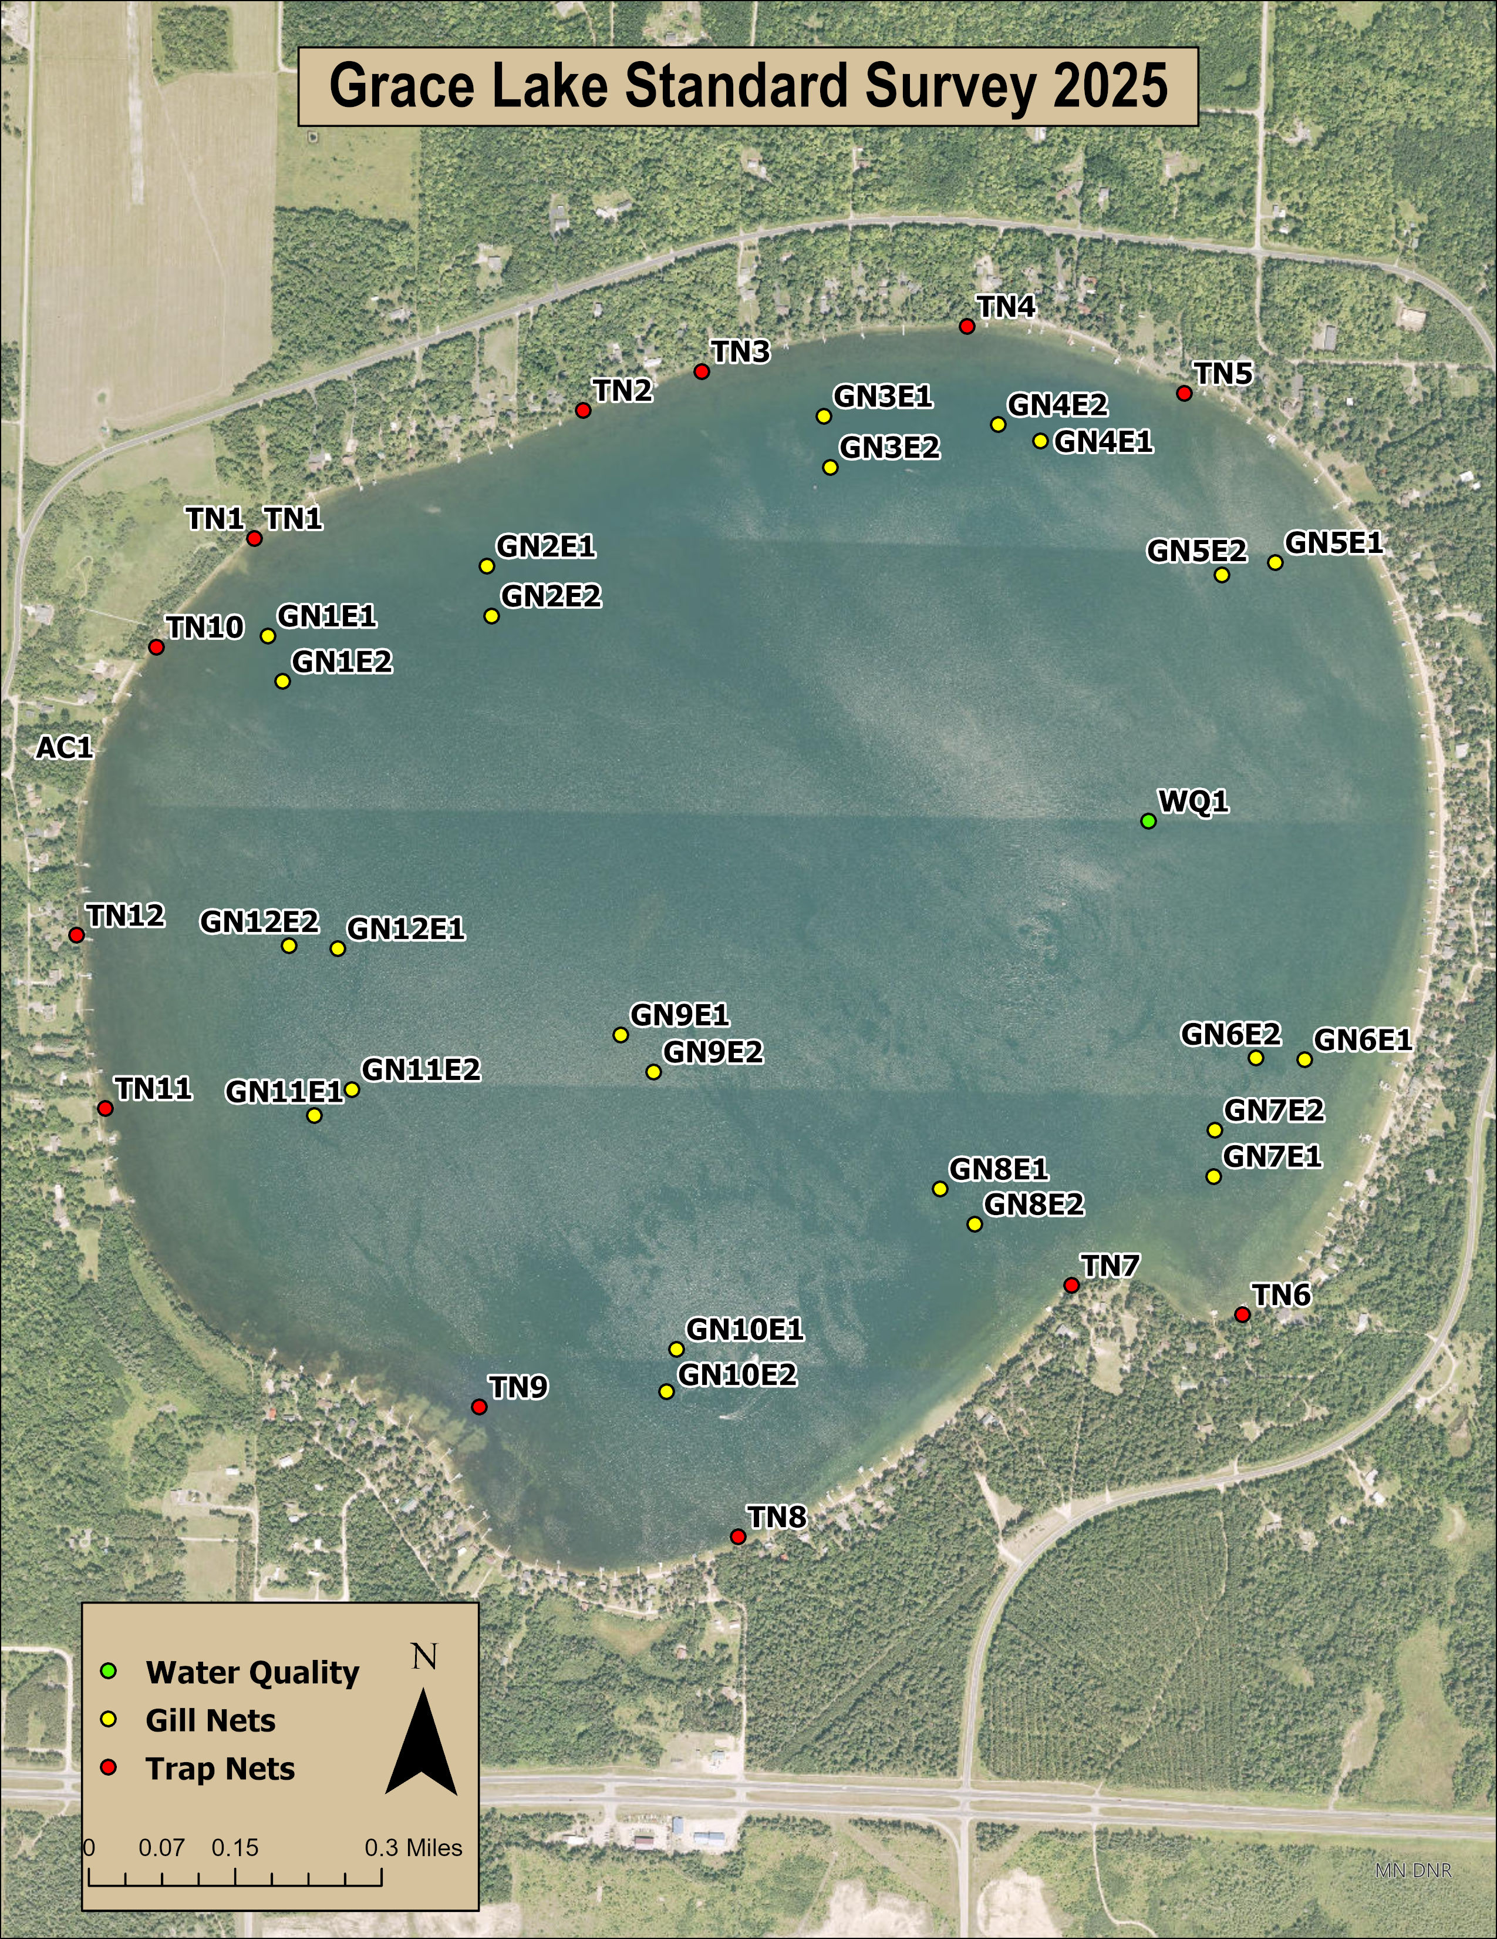
What work is done during a standard survey?
12 Trap Nets
12 Gill Nets
1 Water Quality Assessment

Slide 4
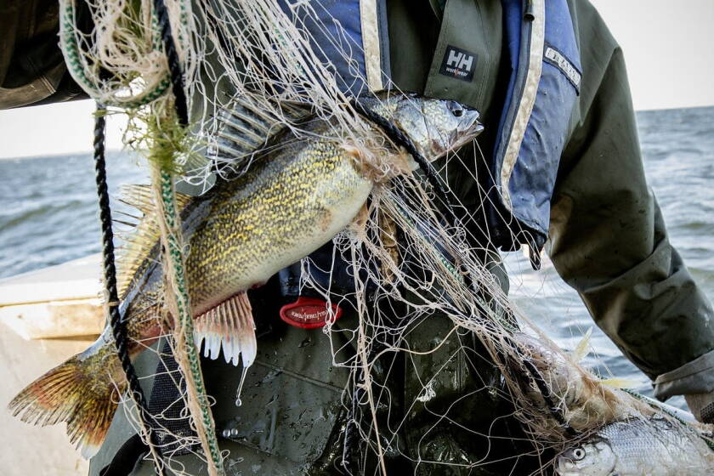
Results – Walleye
CPUE: 5.3 fish/GN
Sizes: 10.4 – 28.5 inches
Mean length: 18.1 inches
Achieving 15 inches by age-6
Year class strength: age-2 (2023, n=12) age-3 (2022, n=11), age-6 (2019, n =14)

Slide 5
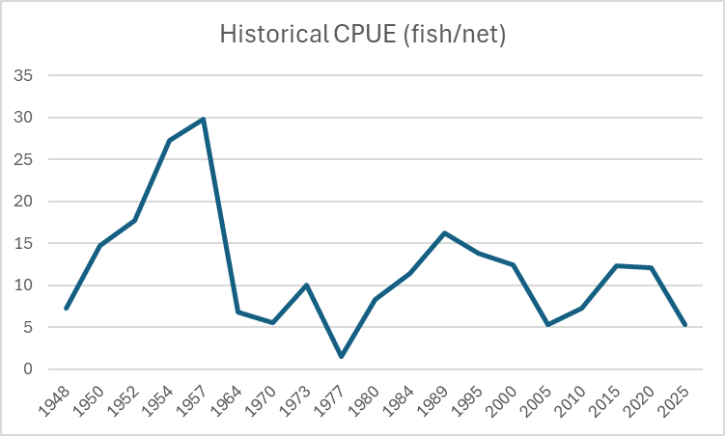
Historical Catch – Walleye

Slide 6
Results – Northern Pike
CPUE: 15.8 fish/GN
Sizes: 14.2 – 34.4 inches
Mean length: 20.3 inches
11% in the 22-26 zone PSL
15% exceeded 26 inches
Abundance of small pike

Slide 7
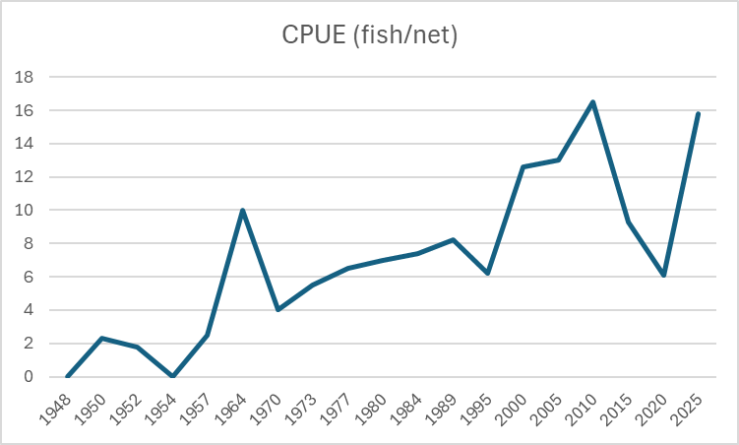
Historical Catch – Northern Pike

Slide 8
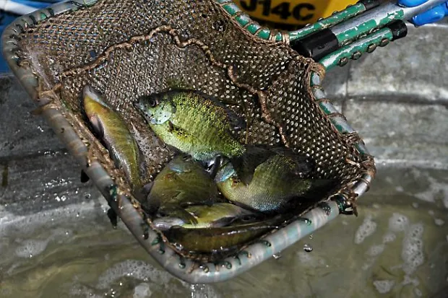
Results – Bluegill
CPUE: 14.6 fish/TN
Sizes: 3.1 – 9.1 inches
Mean length: 6.8 inches
8% of all BLG captured >8 inches
Achieving 8 inches between 6 and 7 years
Recruitment is high and consistent

Slide 9
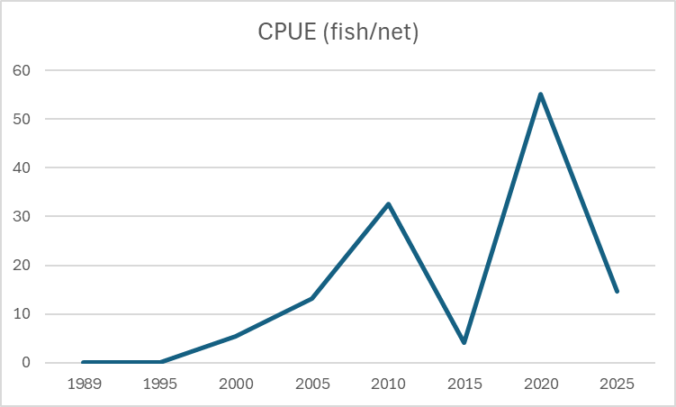
Historical Catch – Bluegill

Slide 10
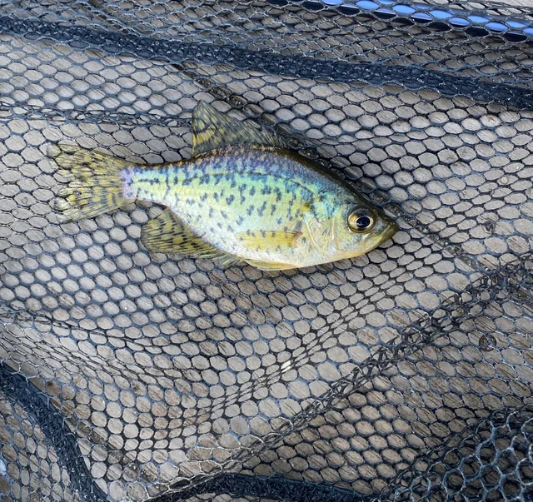
Results – Black Crappie
CPUE: 4.1 fish/GN
Sizes: 5.3 – 12.1 inches
Mean length: 9.8 inches
53% of all BLC captured >10 inches
Achieving 10 inches between 4 and 5 years
2021 year class dominates current pop. (61%)

Slide 11
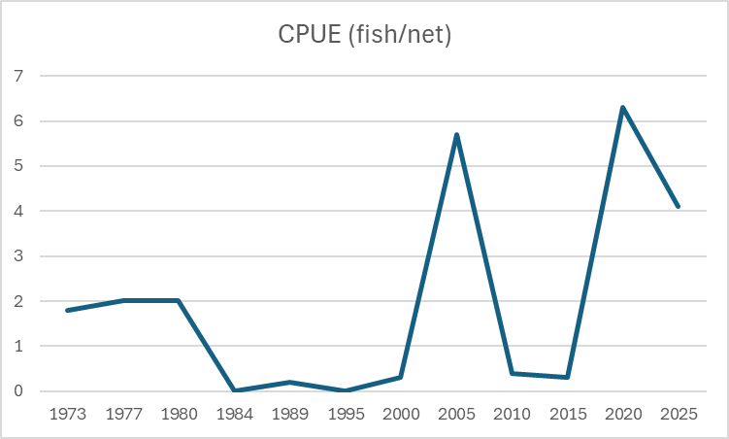
Historical Catch – Black Crappie

Slide 12
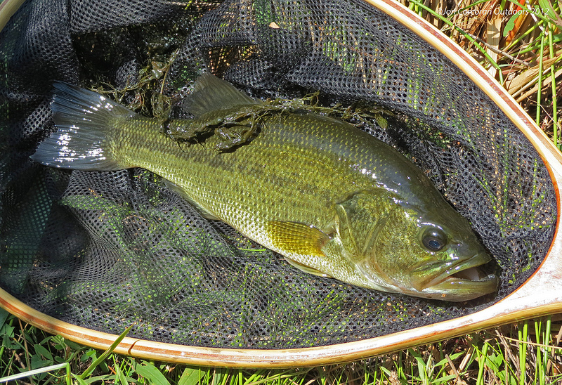
Results – Largemouth Bass
CPUE: 6.5 fish/GN
Sizes: 5.6 – 20.2 inches
Mean length: 11.4 inches
29% of all LMB captured >12 inches

Slide 13
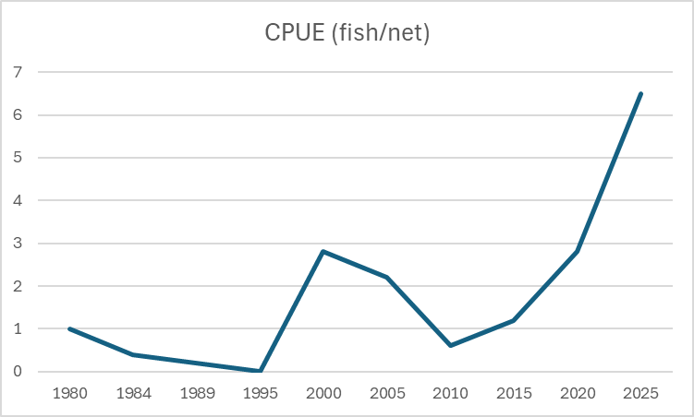
Historical Catch – Largemouth Bass

Slide 14
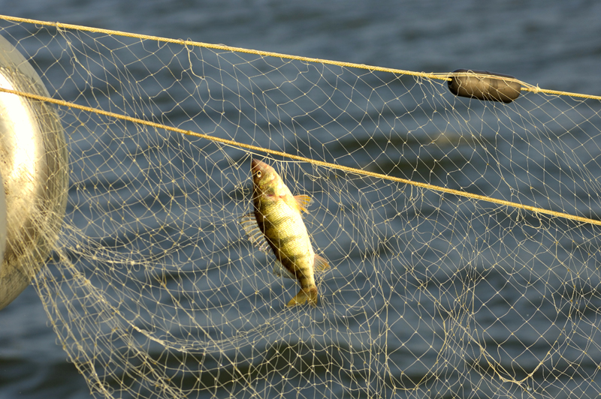
Results – Yellow Perch
CPUE: 8.8 fish/GN
Sizes: 5.5 – 10.3 inches
Mean length: 7.9 inches
53% of all YEP captured >8 inches

Slide 15
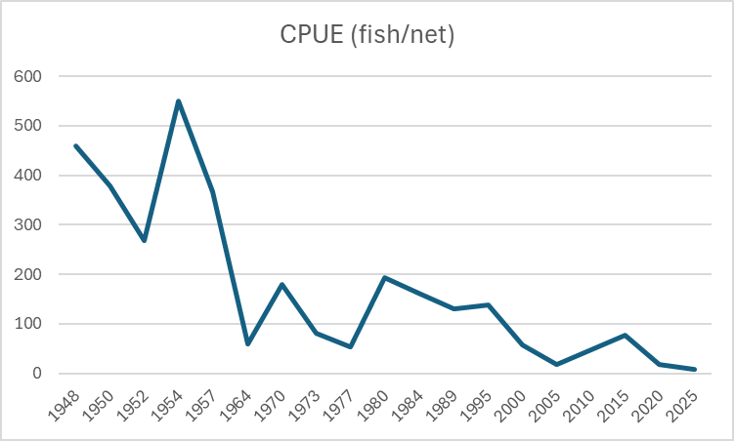
Historical Catch – Yellow Perch

Slide 16
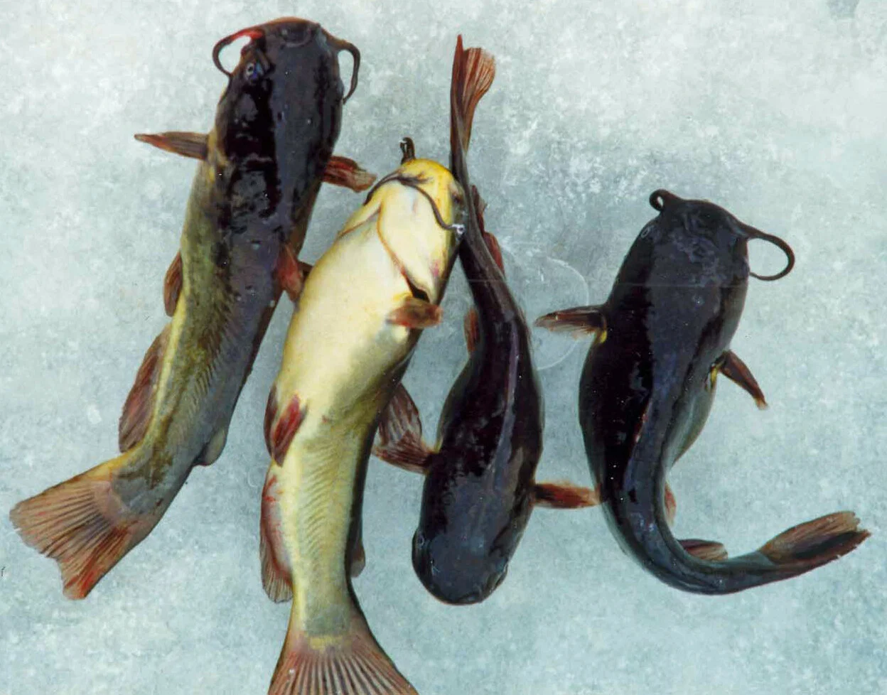
Other species found:
Brown Bullhead
Hybrid Sunfish
Pumpkinseed
Rock Bass
White Sucker
Yellow Bullhead

Slide 17
Any Questions?
Andrew Wiering
DNR Fisheries – Bemidji Area
218-308-2338
Andrew.wiering@state.mn.us

